Slide 1
Can the mínimum wage reduce poverty and inequality in the developing world? Evidence from Brasil
Orlando J. Sotomayor

Slide 2
Abstract
Even though there is growing social support for higher minimum wages as anti-poverty policy tools, very little is known about their effectiveness in reducing poverty or inequality in the developing world. Latin America’s largest economy offers a fertile setting for shedding light on the issue, in being a large and datarich country where frequent increases in the minimum wage can allow for direct estimation of influence on the distribution of income. Using a difference-in-difference estimator that takes advantage of substantial regional income variation and 21 increases in the Brazilian national wage floor, the study finds that within three months of these minimum wage hikes, poverty and inequality declined by 2.8% and 2.4%, respectively. Influence waned over time, particularly with respect to bottom-sensitive distribution measures, a development that is consistent with resulting job loses that fell more heavily among poorer households. The fact that the following annual hike in the minimum wage led to a renewed decline in poverty and inequality, suggests that potential unemployment costs were again overwhelmed by benefits in the form of higher wages among working individuals. However, evidence also establishes an inelastic relationship between wage floor hikes and changes in the incidence of poverty, as well as diminishing returns to the strategy when the legal minimum is high relative to median earnings.

Slide 3
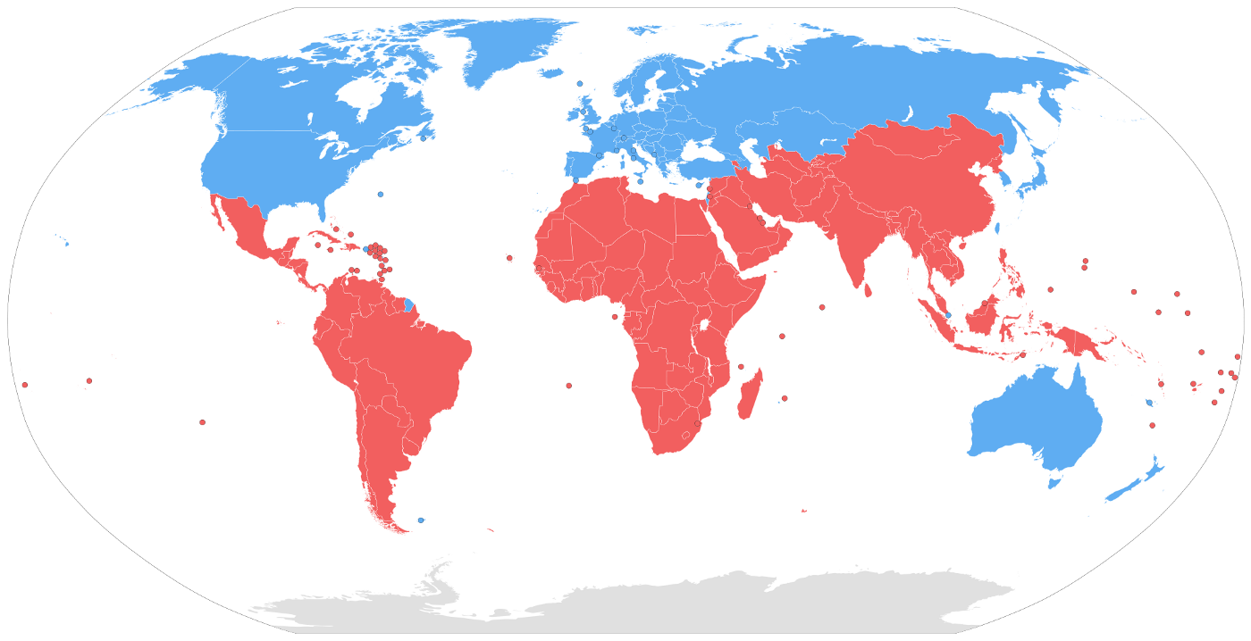
Developed world
A higher minimum wage does not cause meaningful changes in poverty or income inequality, partially as a result of the instrument’s poor target efficiency

Slide 4
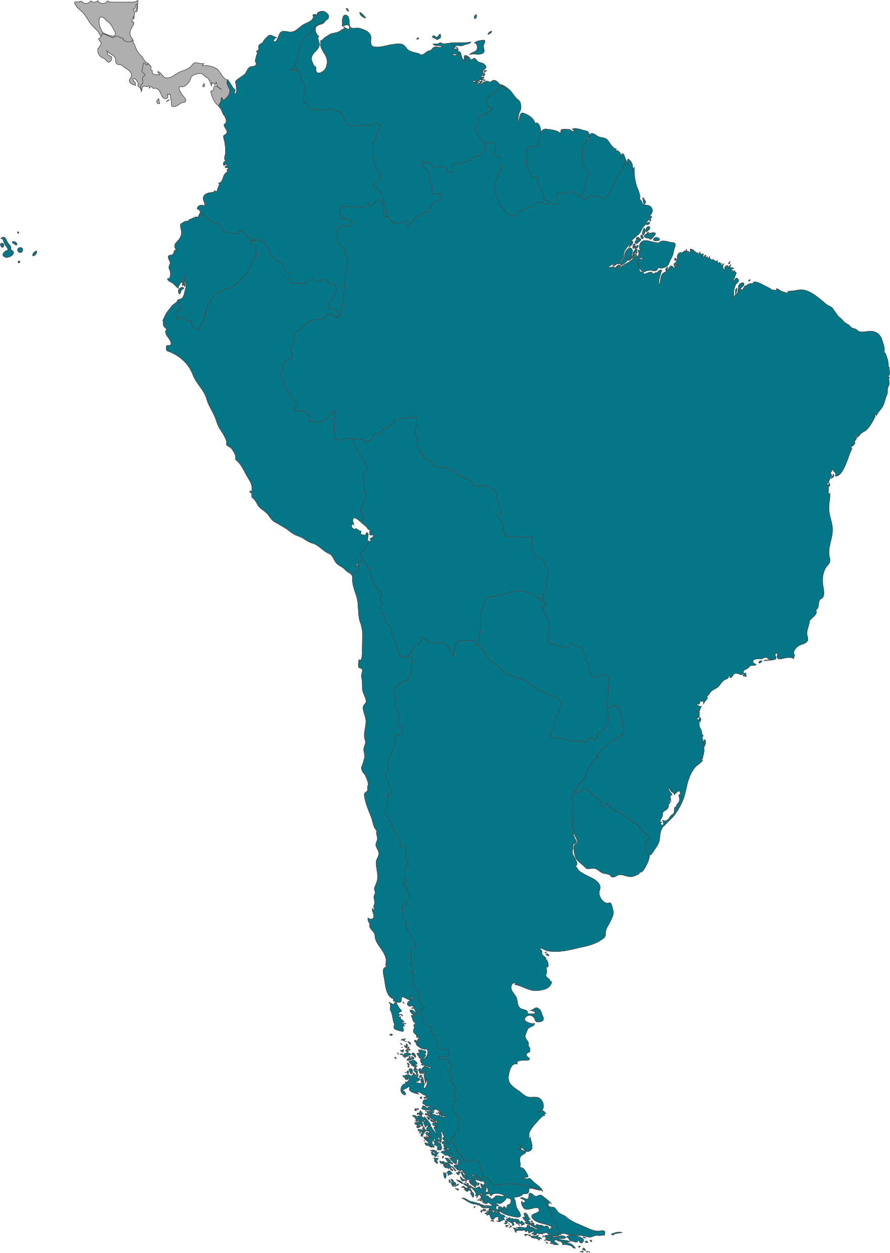
South America
Popular governments have increased minimum wages in the last decades.
Poverty and inequality in the region
Different economic structure

Slide 5
Debate
increases in the minimum wage have little or no effect on employment (Allegretto, Dube, & Reich, 2011; Card, 1992a; Card & Krueger, 1994; Dickens, Riley, & Wilkinson, 2014; Dube, Lester, & Reich, 2010; Hoffman, 2016; Katz & Krueger, 1992)
the wage floor raises unemployment among populations likely to be bounded by it–namely teens and the very low-skilled–and that findings of positive to no effects are generally associated with poor research designs (Neumark, Salas, & Wascher, 2014a; Neumark, Salas, & Wascher, 2014b)

Slide 6
Wage and employment
Studies in Indonesia, Mexico, Trinidad and Tobago, Turkey and other countries shows that mínimum wage hikes generates employment loses in different small sectors and among low-skilled population.
There is other factors that must be studied such as the way the policy is taken, gender gaps, wage levels, firm earnings or job quality.
Bosch & Manacorda (2010).
Alatas and Cameron (2008)
Strobl and Walsh (2003)

Slide 7
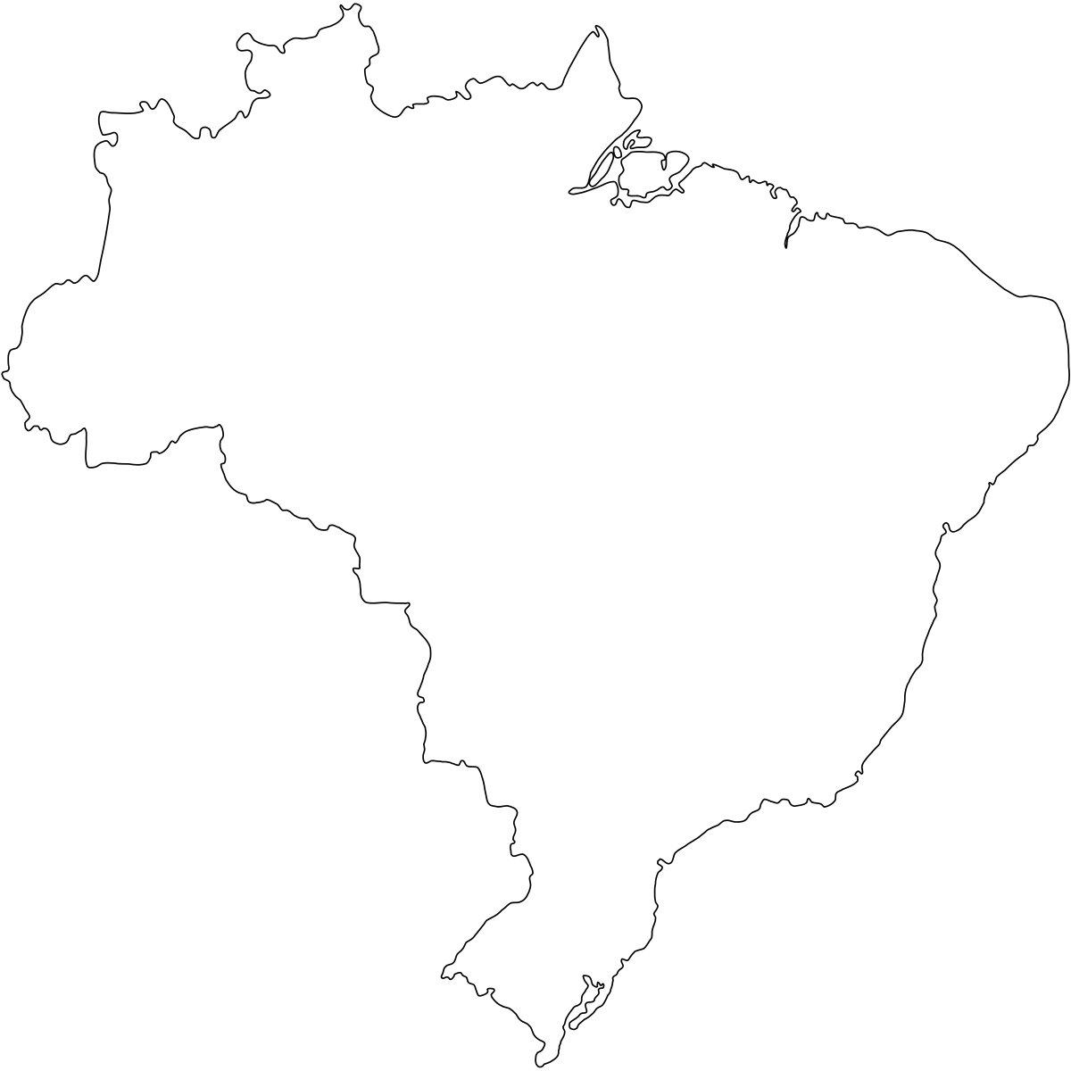
Brasil
Lemos (2004), Lemos (2007), and Lemos (2009) establish that Brazilian minimum wage hikes lead to higher and more equally distributed earnings without loss of employment, even among teenagers and other low-skilled populations
‘’This could be a gap that Brasil and other countries haven’t filled yet ‘’

Slide 8
Institutional setting
During the latter half of the 1990s, wage revisions became effective in May, but between 2000 and 2007 they were effective either in April or in May. Between 2008 and 2010 the effective month for the revisions transitioned to January, where it stood until the end of the period under consideration. The wage floor has no demographic or occupational exceptions and appears largely binding in the informal sector (Lemos, 2009).

Slide 9
Data
Data are drawn from the 1995–2015 Monthly Employment Surveys (PMEs) conducted by the Brazilian Institute of Geography and Statistics (IBGE) in approximately 40,000 housing units located in the country’s main metropolitan areas.

Slide 10
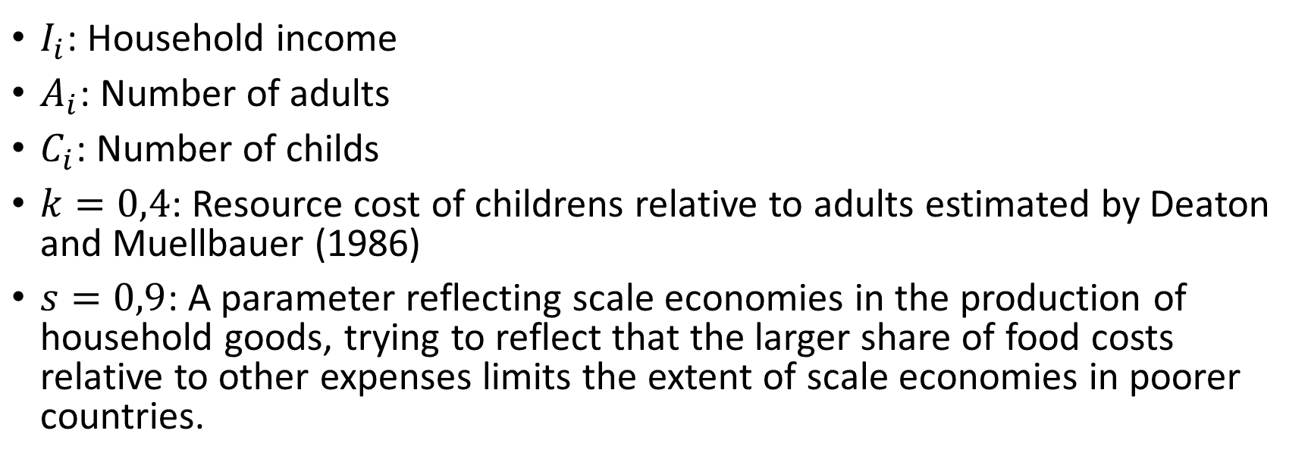

Equivalent household Income
$$\frac{I_{i}}{{(A_{i}+kC_{i})}^{s}}$$
$I_{i}$: Household income
$A_{i}$: Number of adults
$C_{i}$: Number of childs
$k=0,4$: Resource cost of childrens relative to adults estimated by Deaton and Muellbauer (1986)
$s=0,9$: A parameter reflecting scale economies in the production of household goods, trying to reflect that the larger share of food costs relative to other expenses limits the extent of scale economies in poorer countries.

Slide 11
Incomes
Deflated using the National Consumer Price Index (INPC) corresponding with the month the PME was carried out, with a base period of august 1994, the month in wich the precursor of the current monetary unit was introduced
Income distributions are summarized by Atkinson- and FosterGreer-Thorbecke-class distribution measures. Both classes of measures satisfy a number of attractive properties and are defined by a parameter that generates indices with diverse sensitivities to income changes at different points in the distribution.

Slide 12
Poverty
There are no official poverty thresholds in Brazil, and in their place the study adopts those developed by Rocha (1997); Rocha (2003)
Since the PME does not collect data on non-labor income, focus will be placed on changes rather than levels in distribution.
In practice, the most common choices for a have been 0, 1, and 2 (Foster, Greer, & Thorbecke, 2010), producing measures that have been termed to reflect the incidence, depth, and severity of poverty respectively. (Ravallion, 1994)

Slide 13
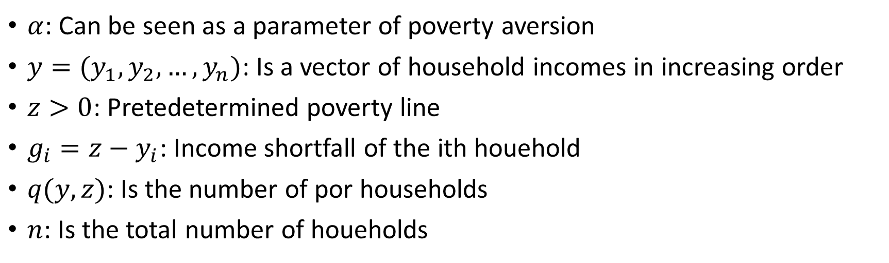

Foster, Greer & Thorbecke (1984) index
A class of decomposable poverty measures
$${FGT}_{α}\left(y,z\right)=\frac{1}{n}\sum_{i=1}^{q}{{\left(\frac{g_{i}}{z}\right)}^{α}}$$
$α$: Can be seen as a parameter of poverty aversion
$y=(y_{1},y_{2},…,y_{n})$: Is a vector of household incomes in increasing order
$z>0$: Pretedetermined poverty line
$g_{i}=z−y_{i}$: Income shortfall of the ith houehold
$q(y,z)$: Is the number of por households
$n$: Is the total number of houeholds

Slide 14
Inequality
Atkinson-class inequality indices are also defined by a parameter that explicitly incorporates aversion to inequality, with higher values generating measures that are more sensitive to income changes at the lower end of the distribution
Amiel, Creedy, and Hurn (1999) find that a parameter value of 0.25 is consistent with elicited attitudes towards inequality
Two other indices reflecting greater aversion to inequality and defined by parameters 0.5 and 0.75 are also incorporated to evaluate robustness of results.

Slide 15
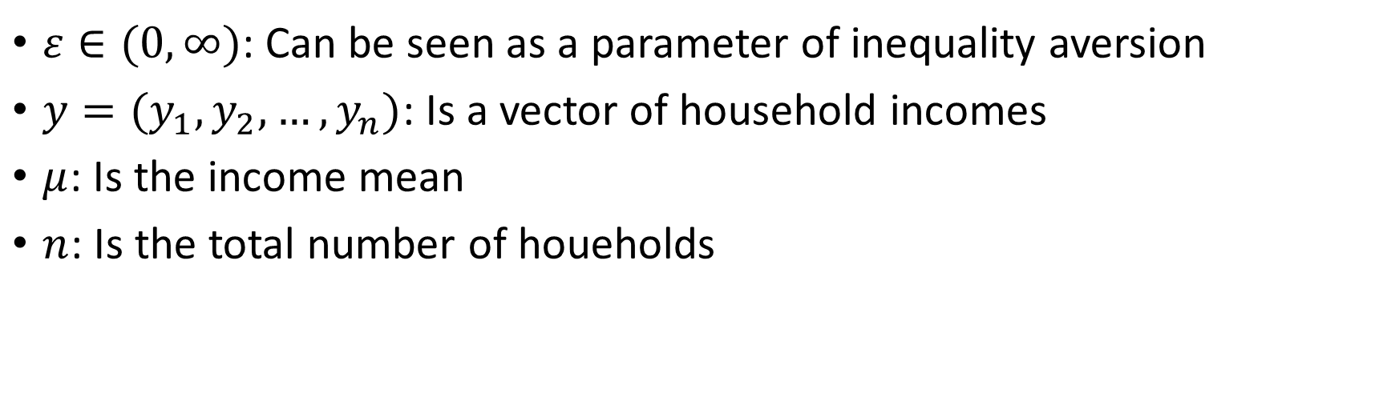

Inequality Atkinson Index
$$A_{ε}\left(y\right)=1−\frac{1}{μ}{\left(\frac{1}{n}\sum_{i=1}^{n}{y_{i}^{1−ε}}\right)}^{\frac{1}{1−ε}}$$
$ε∈(0,∞)$: Can be seen as a parameter of inequality aversion
$y=(y_{1},y_{2},…,y_{n})$: Is a vector of household incomes
$μ$: Is the income mean
$n$: Is the total number of houeholds

Slide 16
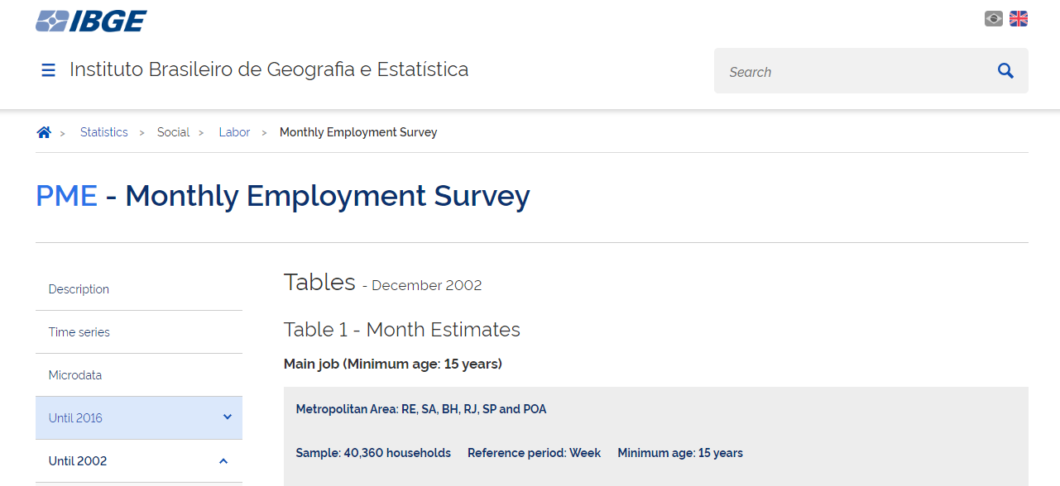
Replication
The Databases was not facilitated by the author
Monthly employment surveys PMEs
1994-2002
2002-2015

Slide 17
PME
The survey follow about 40000 households each month between 1994 and 2016
Six metropolitan areas: Belo Horizonte, Porto Alegre, Recife, Rio de Janeiro, Salvador and São Paulo. The survey collects labor and income information from the population.
Households are visited for two periods of four consecutive months, eight months apart from each other.
There are two versions of PME, traditionally called by PME-Antiga (old PME) and PME-Nova (new PME). The PME-Antiga is the original survey. In 2002, this survey underwent a major change in design, giving rise to the PME-Nova, with a significantly larger questionnaire and differences in the definition of labor market participation, as well as in the rotation scheme of the samples.
Microdata was is structured in a very specific way that makes it difficult to get Access and extract it.

Slide 18
Data zoom
Is a project developed by the Economics Department of PUC-Rio (Pontificia Universidade Católica do Rio de Janeiro). It aims to promote access, processing, and analysis of Brazilian microdata by researchers, students, journalists, and those interested in economic, social, and environmental topics.
Provides statistical packages in STATA and R wich ease the extraction, manipulation, visualization and analysis of Brazilian data.

Slide 19
The problem of identification
Households are correctly identified throughout all eight interviews. However, PME does not assign the same identification number to each individual in the household across interviews.
This turns difficult to have a history of individual income across time.
As a research tool, it is likely best regarded as a long and rich sequence of monthly cross-sections rather than a potential source of panel data.

Slide 20
Methodology
Data Zoom STATA package to extract microdata in a legible way from the IBGE raw downloads
Python code to calculate the indexes and the model

Slide 21
Problems
From IBGE oficial page, data from year 2001 and 2006 is damaged, the archives exists but are incomplete so they cannot be extracted.
Year 2002 have two missing months

Slide 22
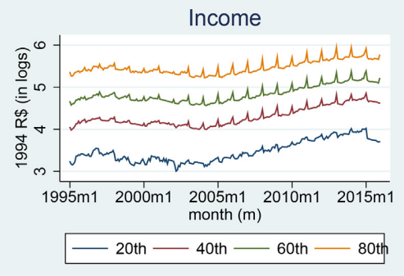
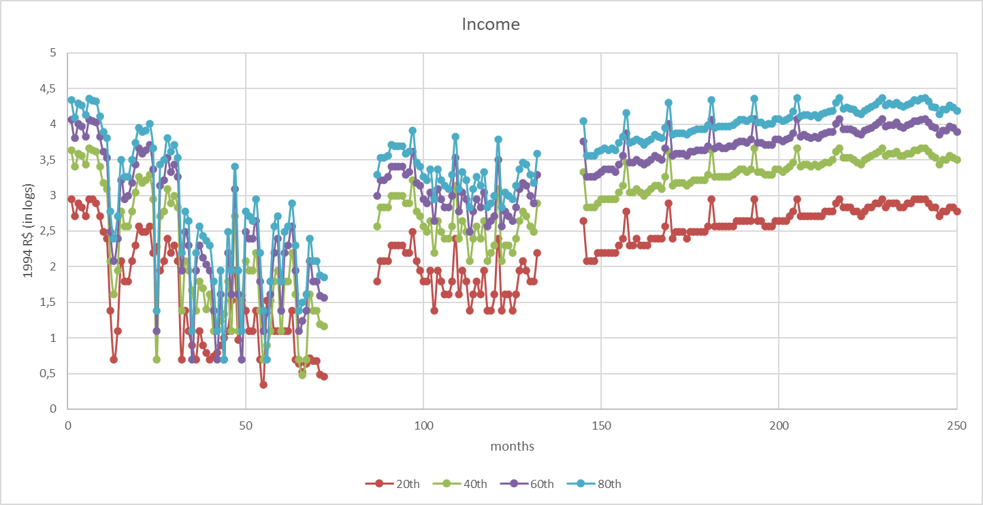
Data

Slide 23
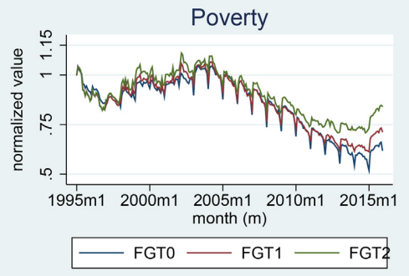
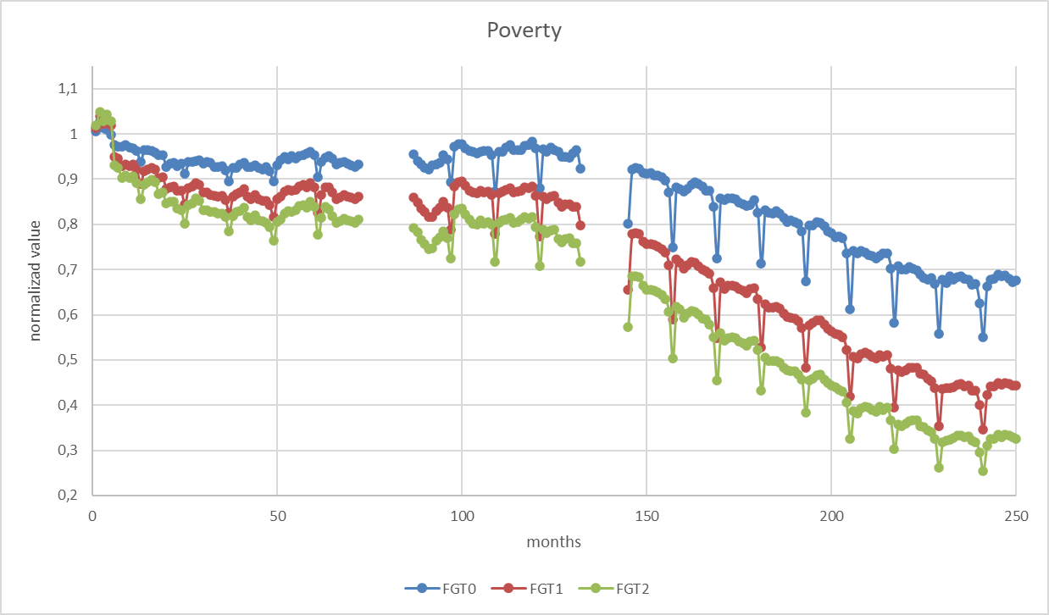

Slide 24
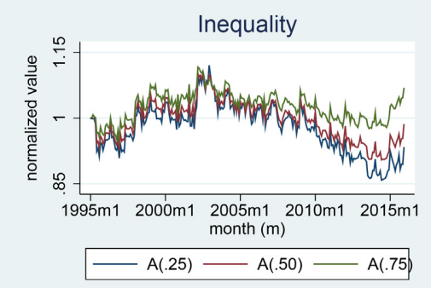
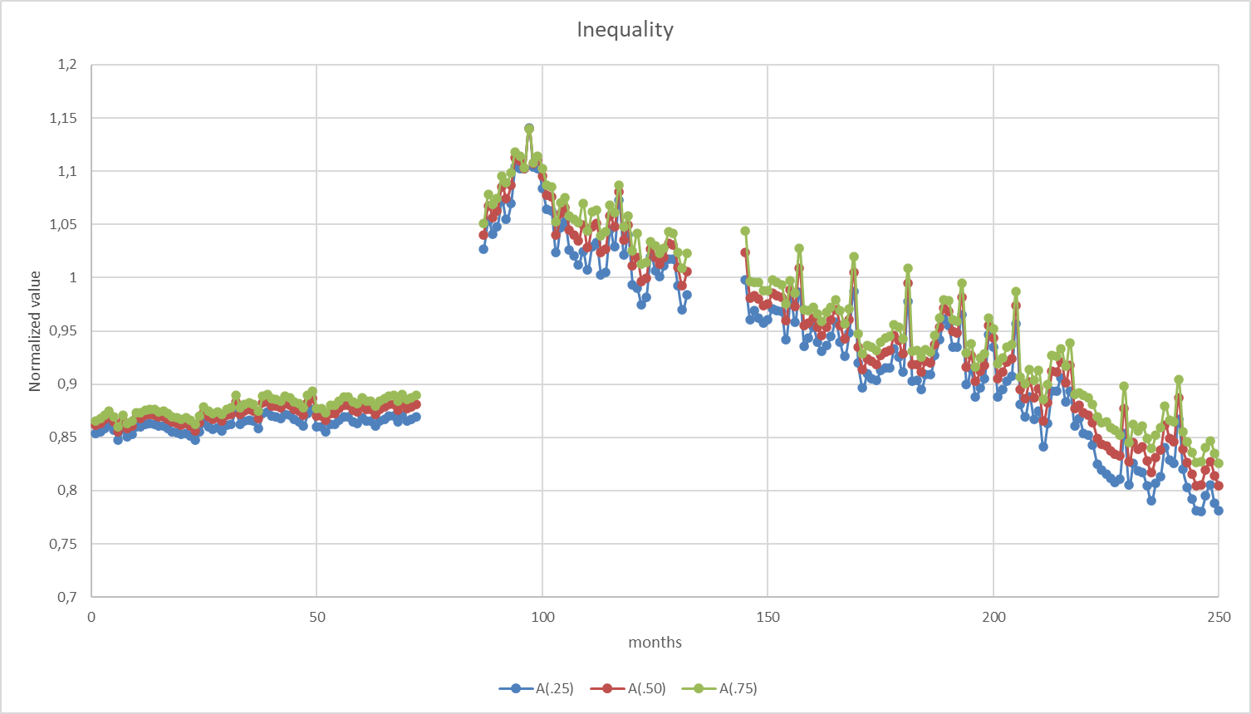

Slide 25
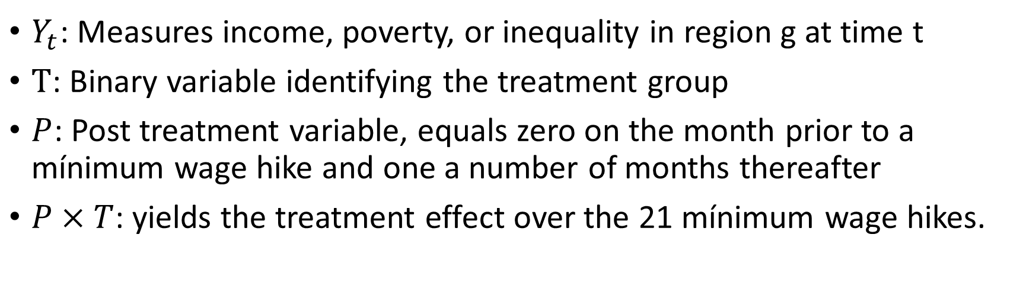

Model
$$Y_{t}=α+β_{1}P_{t}+β_{2}T_{g}+β_{3}P_{t}×T_{g}+\sum_{y=1996}^{2015}{β_{y}{year}_{t}+ε_{gt}}$$
$Y_{t}$: Measures income, poverty, or inequality in region g at time t
$T$: Binary variable identifying the treatment group
$P$: Post treatment variable, equals zero on the month prior to a mínimum wage hike and one a number of months thereafter
$P×T$: yields the treatment effect over the 21 mínimum wage hikes.

Slide 26
References
Sotomayor. O. (2021). ‘Can the mínimum wage reduce poverty and inequality in the developing world? Evidence from Brasil’. World development
See: Burkhouser and Finegan (1989), Burkhouser, Couch, and Glenn (1996), Burkhouser and Sabia (2007), Campolieti, Gunderson, and Lee (2012), Card and Krueger (1995), Sabia (2008), Sabia (2014), and Sabia and Burkhauser (2010)

